Slide 1
Decentralized Voting System
Alieel & Pratyush

Slide 2

Objective
Our software harnesses the power of blockchain technology, integrated alert systems, and anomaly detection to improve the electoral process. Utilizing these diverse tools not only ensures that every vote is accurately counted and verifiable but also significantly enhances the integrity and trust in elections by making the entire voting process transparent and immune to tampering.

Slide 3


How we did this?
We created a connection to a SQLite database where our voting data is stored. This is important because this is how we manage our voting data securely and efficiently.
Then we implemented three different tools to make sure that the voting process works smoothly, blockchain for voter integrity, email alert system, and anomalies detection system.

Slide 4
Feature breakdown

Slide 5
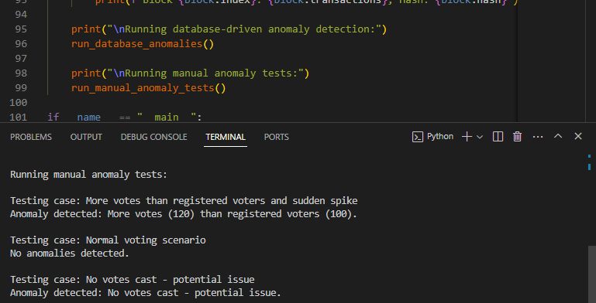
Anomaly detection
We developed this tool using Python and Pandas to enhance the security of elections. It helps identify unusual patterns, such as a sudden increase in voter registrations or strange voting trends, which might suggest possible fraud. For instance, in the example below, our system detected that there are more votes than there are registered voters. As shown in the output, it immediately alerts us.

Slide 6
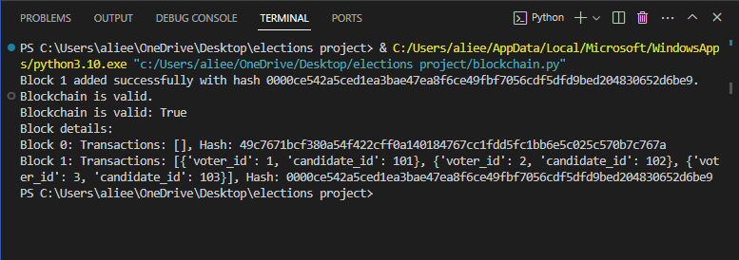
Blockchain for Vote Integrity
How it works is that when we have some new votes, we prepare a new block. Each vote records a voter’s ID and the candidates they voted for. Then the system uses a process called ‘proof of work’ to find a special number (nonce) that makes the block’s unique code (hash) start with ‘0000’. This is like solving a puzzle to ensure the block is secure before adding to the chain.
Each block is linked to the previous block by using the previous block’s unique code. This forms a chain that keeps all previous voting information secure.

Slide 7
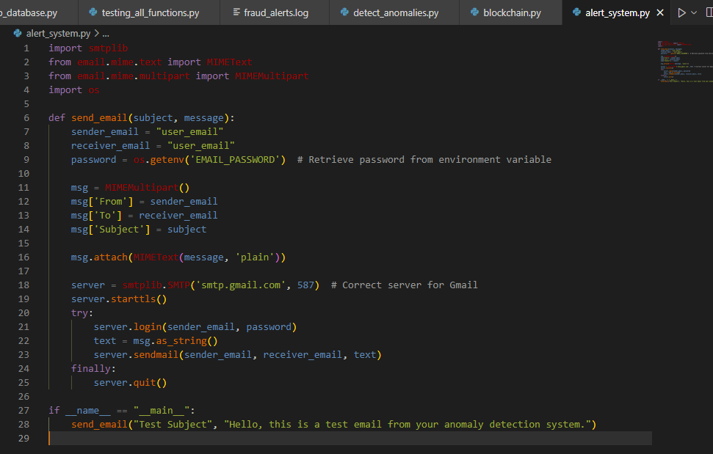
Alert system
In addition to our anomaly detection tool, we've integrated a system that automatically sends an email when an anomaly is detected. This feature is implemented using the smtplib, email.mime, and os libraries. The code configures sender and receiver email addresses then it secures the sender’s email password using an environment variable to enhance security.
Example below:

Slide 8

Impact
Our blockchain-based voting system leaps forward in electoral integrity and access. By embedding advanced anomaly detection and real-time alert systems, we empower election authorities to swiftly address potential discrepancies, safeguarding every step of the voting process. More than just counting votes, our technology fosters inclusivity and engagement by enabling remote, secure voting options, making it easier and more appealing for citizens to exercise their democratic rights.

Slide 9
Thank you!

